Slide 1
IT Incident Management Sid Savara siddarth@hawaii.edu Technical Manager Management Information Systems

Slide 2
OH NO!!!
It’s OK, ITS is on it

Slide 3
Mama always said life was like a box of chocolates. You never know what you're gonna get.

Slide 5
flickr.com/photos/kirpiphoto/4574296466

Slide 6
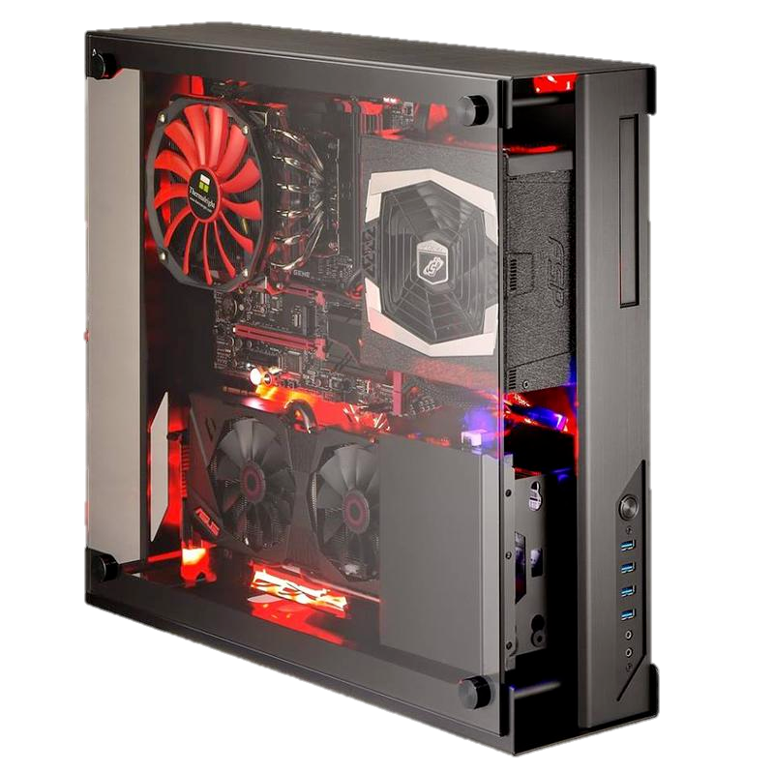

Slide 7
What Is An Incident?
An Incident Is…
Outage
Slowdown
Of ITS Service or Application

Slide 8
Incident Management
OH NO!
It’s Ok

